Slide 1
Introduction
CS 3450
Introduction to Software Engineering

Slide 2
Why is this class required?
Software Engineering teaches us how to ensure that our products meet the expectations of the customer
The teacher and TA will act as your customer. Your grade depends on how well you meet our expectations with your final product
This class will see the design and execution of a large scale, non-trivial programming project
More details on the project to follow
For most Computer Scientists at USU, this will be the first time you’ve worked on a large group project
Instead of working by yourself, you will be required to participate in a group, and your group will help determine your grade through peer evaluations

Slide 3
Teams
The class will be divided into teams. You get to choose your team, so be sure to choose wisely
What makes a programming team successful?
What makes a programmer an asset to a team?
What can you avoid to be a helpful team member?
What can you do to be sure that all team members contribute equally?

Slide 4
Teams
A team will consist of:
Project Manager
This role is extremely important. The PM will ensure the on time delivery, as well as quality, of the product
Documenter
This role will ensure that all documentation is kept up to date. They will NOT be solely responsible for all documentation
Programmer
This role is to write clean, concise code with the corresponding documentation
Tester
This role is to ensure the usability and validity of the product. All team members should test, but the “Tester” oversees all testing

Slide 5
What is required?
This semester, you will have two main requirements (besides tests):
UML Documentation, consisting of:
Requirements
Use Cases
Class Diagrams
Test Cases
User’s Guide
Project, consisting of:
In-class demonstrations
The finished project, and code
Final documentation, including contribution notes
Peer evaluations will be required with all submissions

Slide 6
When will everything be due?
I will introduce new material every Monday. Wednesday and Friday will be a review of that material, as well as in-class time to work on your projects
Please be aware that you will NEED out of class time to work on your projects. This class cannot be completed with the time given you in class
Be sure that those in your group have similar schedules to you
You will have one week to add the new material to your documents and resubmit them.
This means that all homework will be due on the MONDAY at 11:59 PM following new material being introduced.
This gives you about a week to complete the new material. It is more than enough time

Slide 7
How will you turn things in?
We will be using GitHub for the course
‘master’ branch will be used for anything being turned in
Please use a development branch for any in-development code and documentation
Pushing code to master, is essentially the same as turning it in
When an assignment is due, we will pull your master branch, and use that for grading
Please have a /documentation/group#.pdf document – this is what will be graded for the documentation sections
Please have a /code/ folder – this is what will be graded for the code sections

Slide 8
Project

Slide 9
Teams
First we need to break into teams
Things to consider when choosing teammates:
What role do they want in the group?
What role do YOU want in the group?
Are your schedules similar?
What languages are they familiar with?
Do they have any real-world experience?
What benefit would they bring to your team?
Why do they want to be on your team?
Remember that working with friends can be bad.

Slide 10
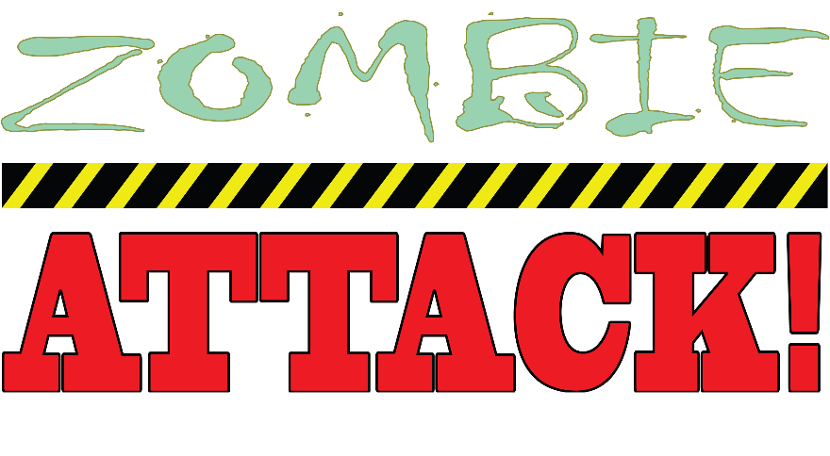
Project
You will be creating a website for the game Zombie Attack
Zombie Attack is an online game where you run away from and attack zombies. You have been contracted to create our new website

Slide 11
Zombie Attack!
In the most basic sense, Zombie attack will be:
A place to design a zombie infested map
A place to play your maps with friends
There will be 3 types of users in the system. They are…

Slide 12
Zombie Attack!
Player
Player can edit their account
Player can view a list of maps that are available to play
Player can select a map, and play using our engine
More in this later

Slide 13
Zombie Attack!
Designer
Designer can create a map using pre-determined tiles
Exact tile list to come
More on designer later
Designer can edit their account
Designer can view and edit existing maps
Designer can also be a player

Slide 14
Zombie Attack!
Administrator
Administrator can do everything a player and designer can do
Administrator can Add/Remove users
Administrator can View/Remove maps

Slide 15
Zombie Attack! – Map Designer
Maps will be built in square chunks, and then assembled into a larger map
Designer should be able to:
Create and edit maps
Tiles/events/objects will be the main design elements
Different layers will be used (cloud layer, tree layer, ground layer)
Use keyboard shortcuts
You decide what shortcuts are helpful and implement them!
Use an optional grid to help layout tiles
Copy and paste sections of map
Right/Left click assignments
Undo/Redo – Preferably with their standard keyboard shortcuts
Maps should auto-save 15 seconds after a change, or with an explicit save
Reset 15 second counter if a change happens

Slide 16
Zombie Attack! - Server
The server will accomplish the following tasks (besides serving pages)
Save maps to a database
Save users to a database
Handle sessions
User should be logged out after 20 minutes on inactivity
Should upload maps to our server when about to run
Should not allow a user to do anything out of their permissions

Slide 17
Zombie Attack!
Final Notes:
We will provide the logo that was shown, but you are responsible for all other design issues
3% extra will be awarded to the team with the best designed interface
Questions will be answered as the customer would answer them

Slide 18
Questions
Remember that a customer may not have given you enough information to complete your job.
The customer may also not know what they would like. You ought to suggest things to make them happier.
7% of your project score will be suggestions that YOU make.
This means that to receive an A on the project, you need to help the customer understand what they’re looking for by suggesting extra features you can include – and then implement them!

